Slide 1
Business Forecasting Project
Aryan Patel

Slide 2
The Data
The original data is from this kaggle website : https://www.kaggle.com/datasets/berkeleyearth/climate-change-earth-surface-temperature-data/data?select=GlobalTemperatures.csv
The original data contains average monthly temperature data for 243 countries from 1743 to 2013 .
Three most cited land and ocean temperature data sets are NOAA’s MLOST, NASA’s GISTEMP and the UK’s HadCrut. The authors have repackaged the data from a newer compilation put together by the Berkeley Earth, which is affiliated with Lawrence Berkeley National Laboratory.
The Berkeley Earth Surface Temperature Study combines 1.6 billion temperature reports from 16 pre-existing archives.
We can be confident that the recorded data is accurate , especially if we filter for more recent years as the technology to record temperature more accurately has improved with time.
I am interested in predicting the global average temperature , so I grouped by country and and took the average to get monthly global average temperatures.
In order to be more confident that the recorded data is the true temperature , filtered original dataset for 1900 and on .

Slide 3
The Problem
Global temperatures are rising which can have many negative consequences such as rising sea levels , more extreme weather , effects on agriculture and water , as well as causing economic damage .
Being able to accurately forecast the global monthly average temperature is important to be best prepared for the impact of global warming.
The goal of this project is to be able to find a time series model that is robust and generalizes well so that we are able to accurately forecast the monthly global average temperatures well into the future, so that we can be prepared for global temperatures rising and know when we will have to take action.

Slide 4
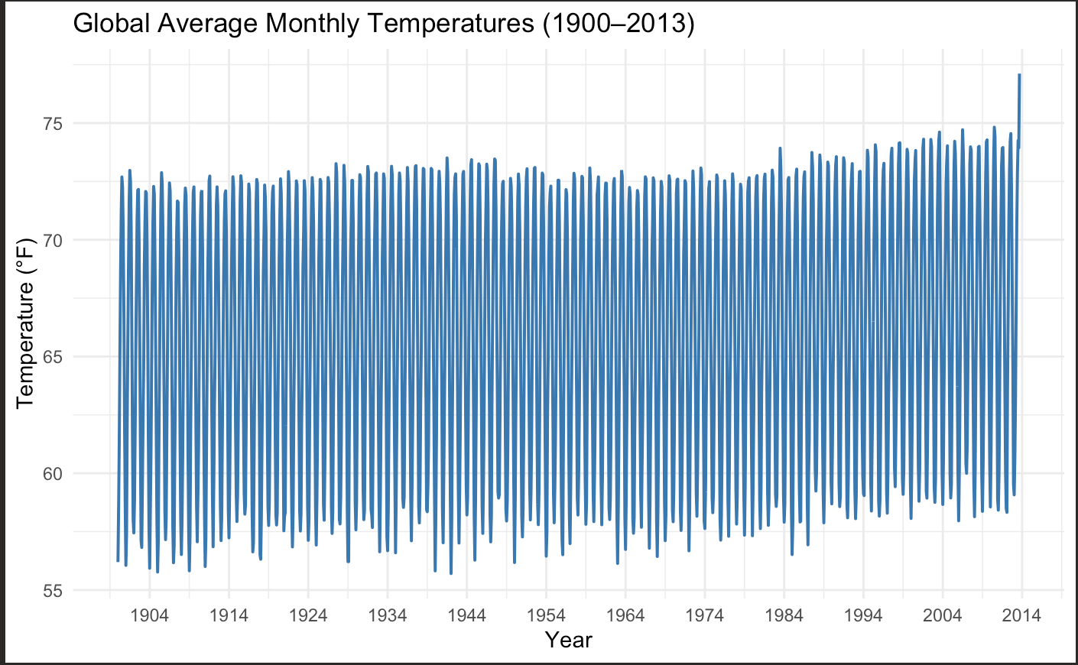
Data Preparation
As older methods of collecting temperature may not be as reliable , we will filter the data for 1900 and onward.
The original data provides temperature in celsius , as we are more accustomed to fahrenheit we will convert the temperature to fahrenheit.
Convert Temperature as time series object

Slide 5
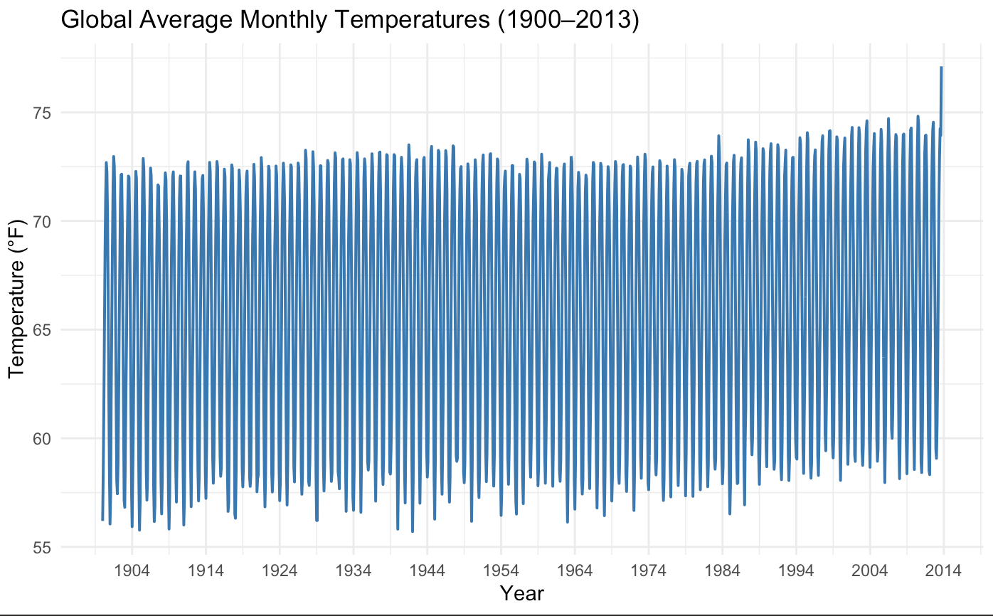
Methodology
-First step after our data cleaning and preparation is , splitting our data into test and train . As we want our model to be robust and generalize well to the future , we will hold out the last 12 months of data from our time series as test and the rest will be used for actually training and fitting the time series model on our data . This will give us an unbiased and and clearer view of how the model is performing to data it has not seen before in training .
- We can see there is a big spike in global monthly average temperature in the last few months . The model that is able to most closely predict this spike without actually seeing the data is the one that will generalize well for future predictions.
- As with most models as we increase the parameters and complexity we can make the model almost perfectly predict and fit the training data (high variance low bias) . But the key will be to get a model to predict well on unseen data that is stable and generalizes well .

Slide 6
Methodology PT 2
For Time Series Models that we will be using : 1.Naive , 2.Simple Moving Average (3) , 3.Simple Exponential Smoothing , 4.Holt Winters , 5.ARIMA / SARIMA
Each model will be fit on the same training data , and then we will use the model fit on the training data and evaluate on the test set and then calculate metrics on the test set to see its true performance .
I will use MAE (Mean Absolute Error) and RMSE (Root mean squared error) . MAE is is easy to understand and lets us know on average how off is our prediction from the true value and is robust to outliers . RMSE penalizes large errors so especially as our holdout set the last of data has a big spike this will let us know if the model struggles with extreme values and swings.

Slide 7
Methodology PT 2
We will also conduct exploratory data analysis to get a better understanding of the data before we start modeling
In addition we also conduct residual analysis for all of the models to ensure that the model captures all of the structure in the data and if the model is actually valid for the data in addition to having the best MAE / RMSE on the test set.

Slide 8

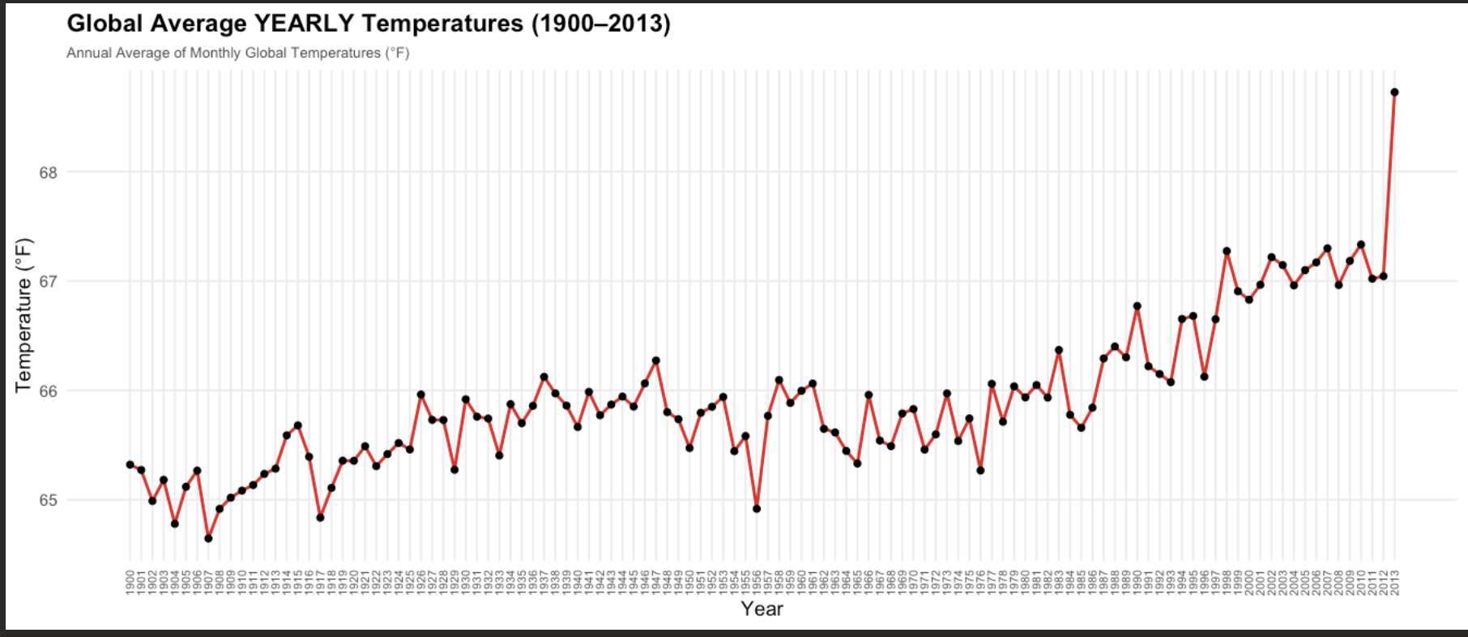
Exploration
Plotting the monthly temps from 1900-2013 the plot is too crowded mostly we can just the swings due to seasonality hard to know what data should be kept and if we should further filter to capture the current trend
Now viewing the yearly temperature plot we can see there is an upward trend starting in 1956 . So we will filter our entire dataset to be 1956 and onward and keep the last year as our hold out / test set .

Slide 9
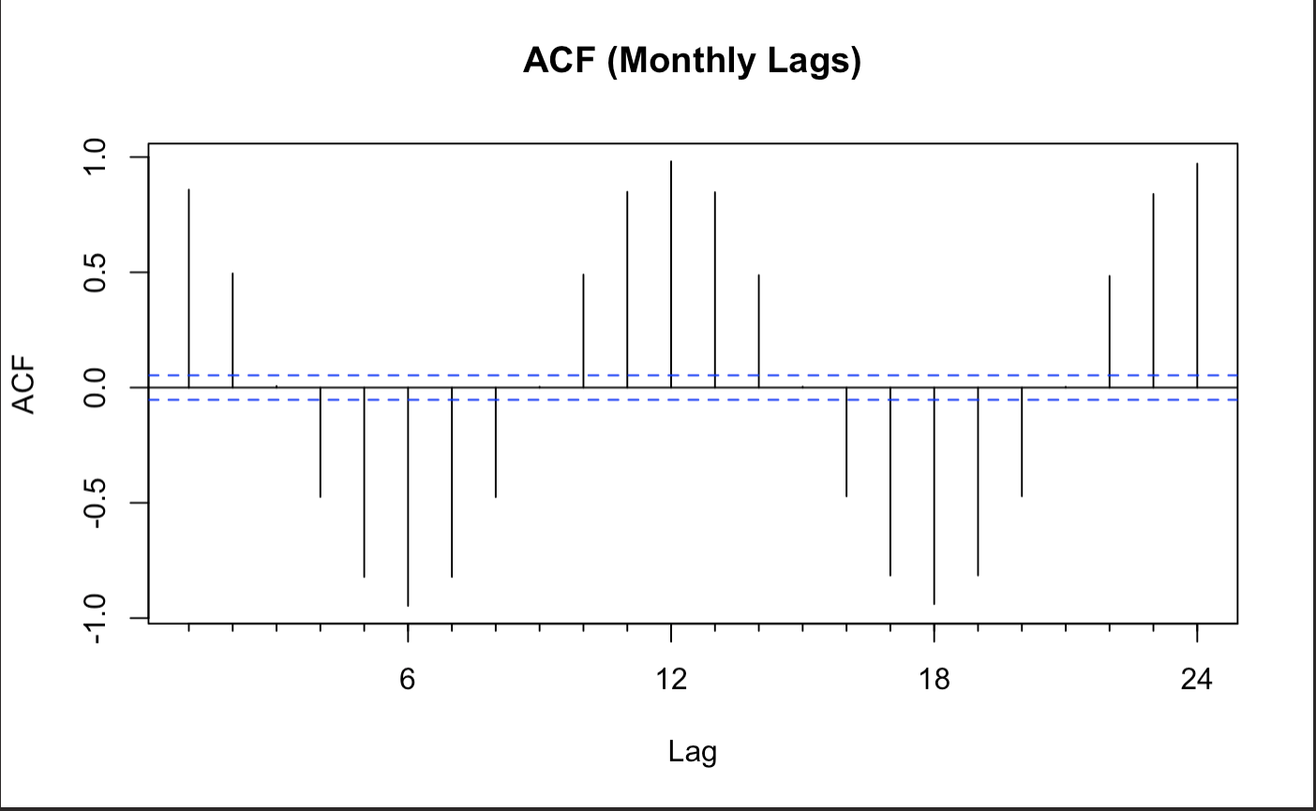
Exploration
From viewing the acf plot we can see significant spikes at lag 1 , 2 , 6 , 12 , 18, 24. Intuitively these spikes make sense as to predict the upcoming months weather the previous 1-2 months will be important . In addition using the same temperature from the same time but last year or two years ago for the same period will be useful. We can also see the half year and 18 month lags are significant but negatively autocorrelated which also makes sense.

Slide 10
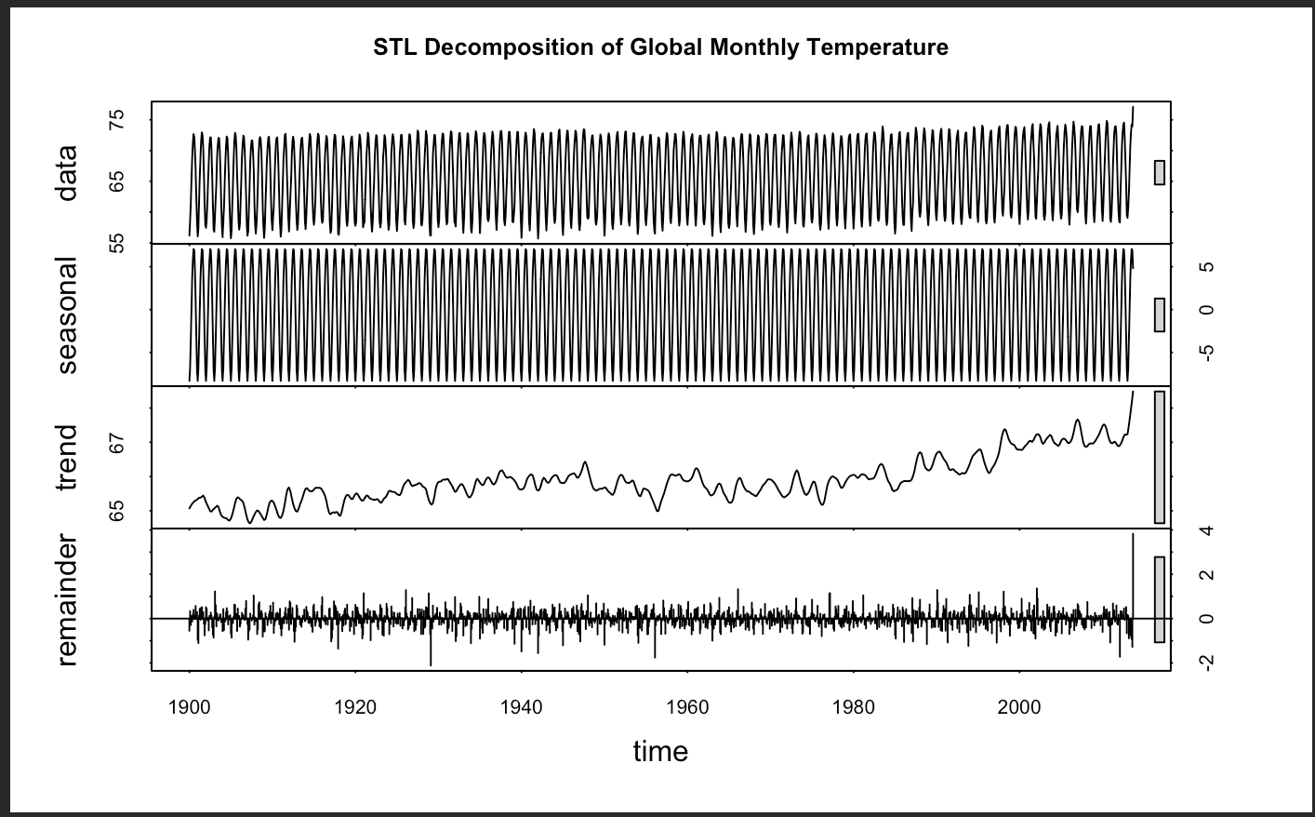
Exploration
From the STL Decomposition of our time series . We can see that there is a strong seasonal component as expected as we have monthly global average temperatures . There is an upward trend also as expected due to climate change , more use of fossil fuels with time , and other reasons .

Slide 11
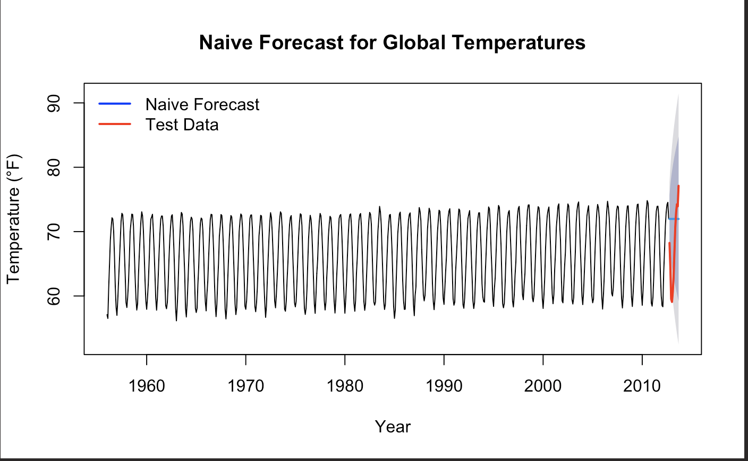
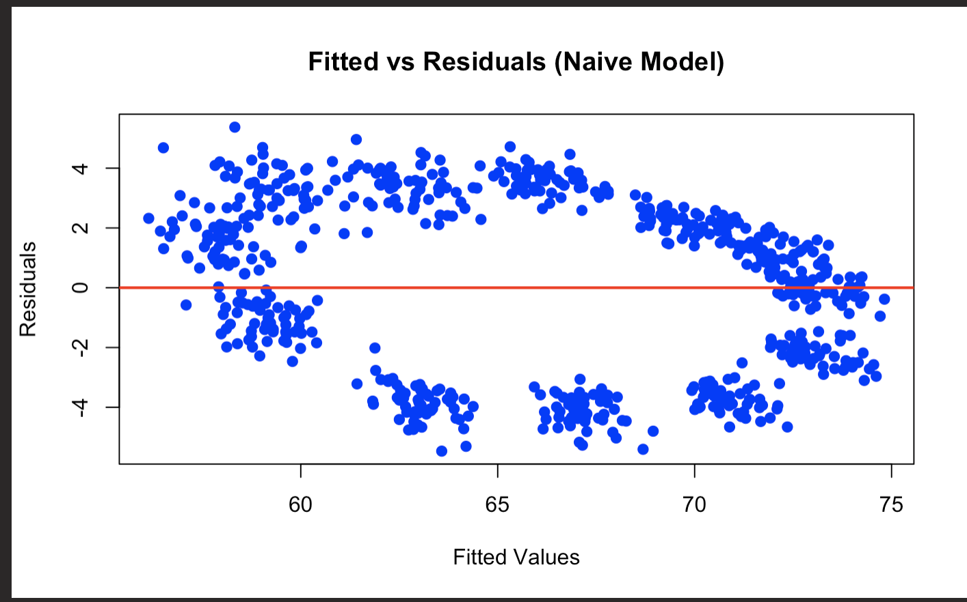
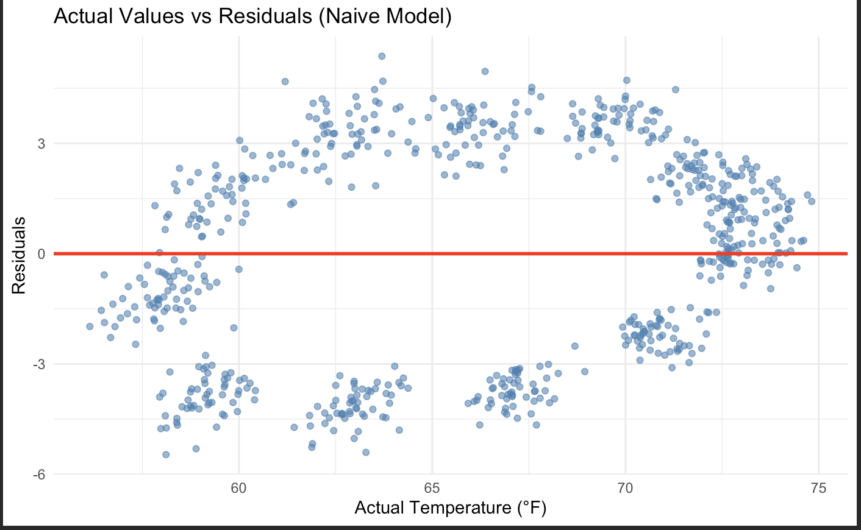
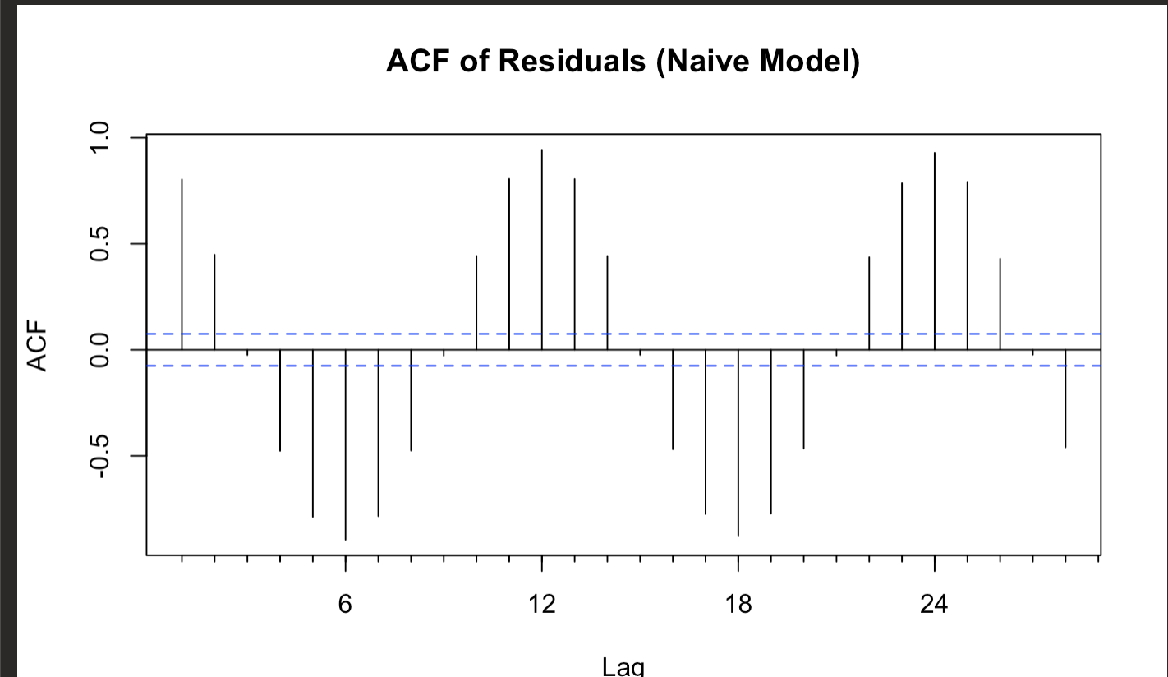
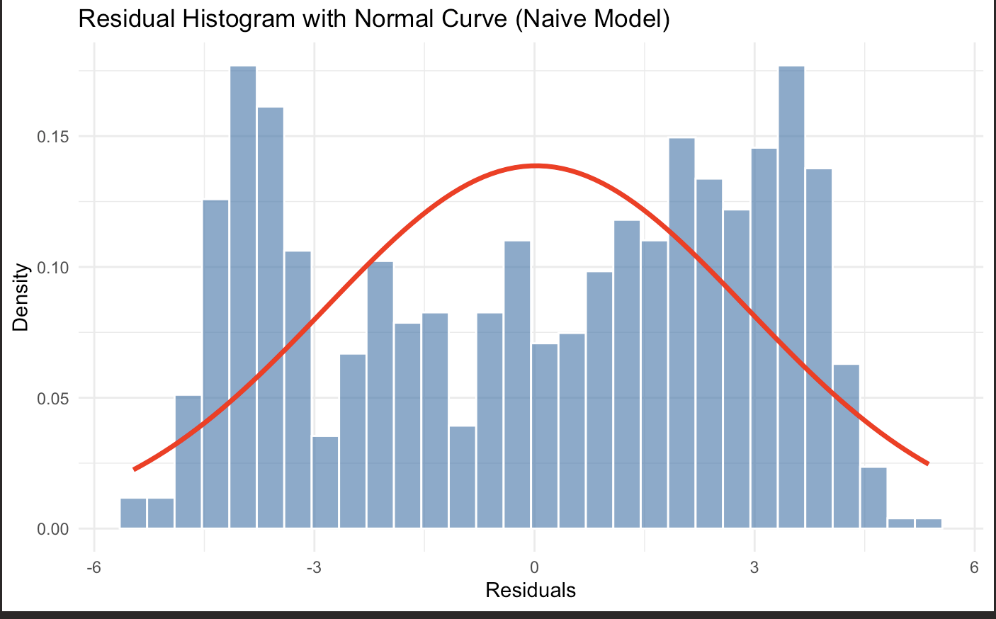
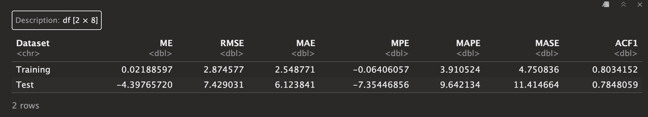
Model # 1 Naive

Slide 12
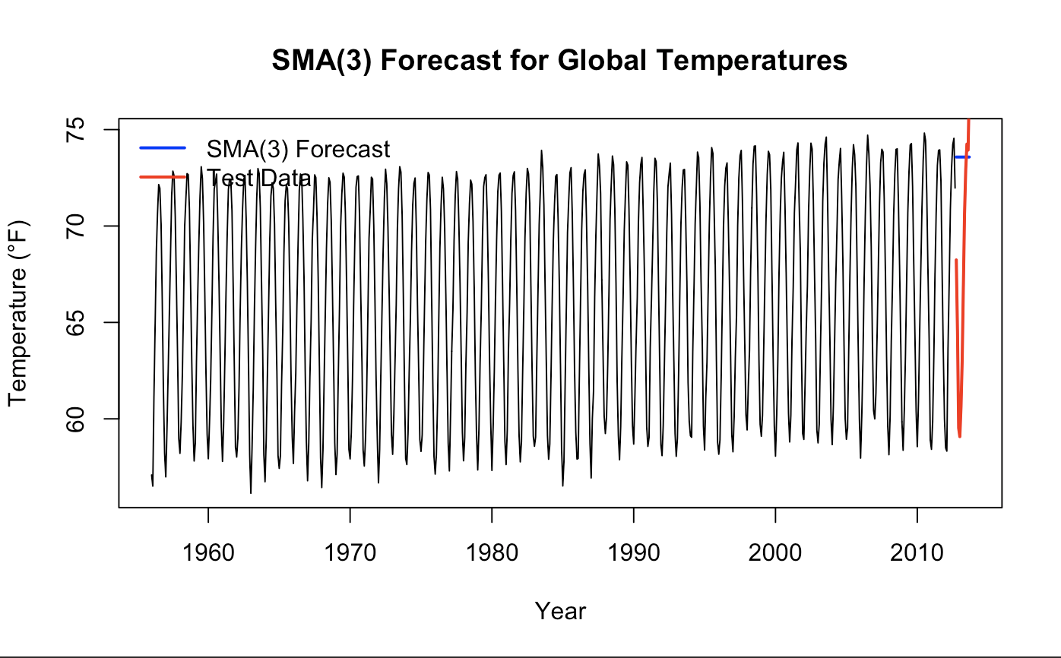
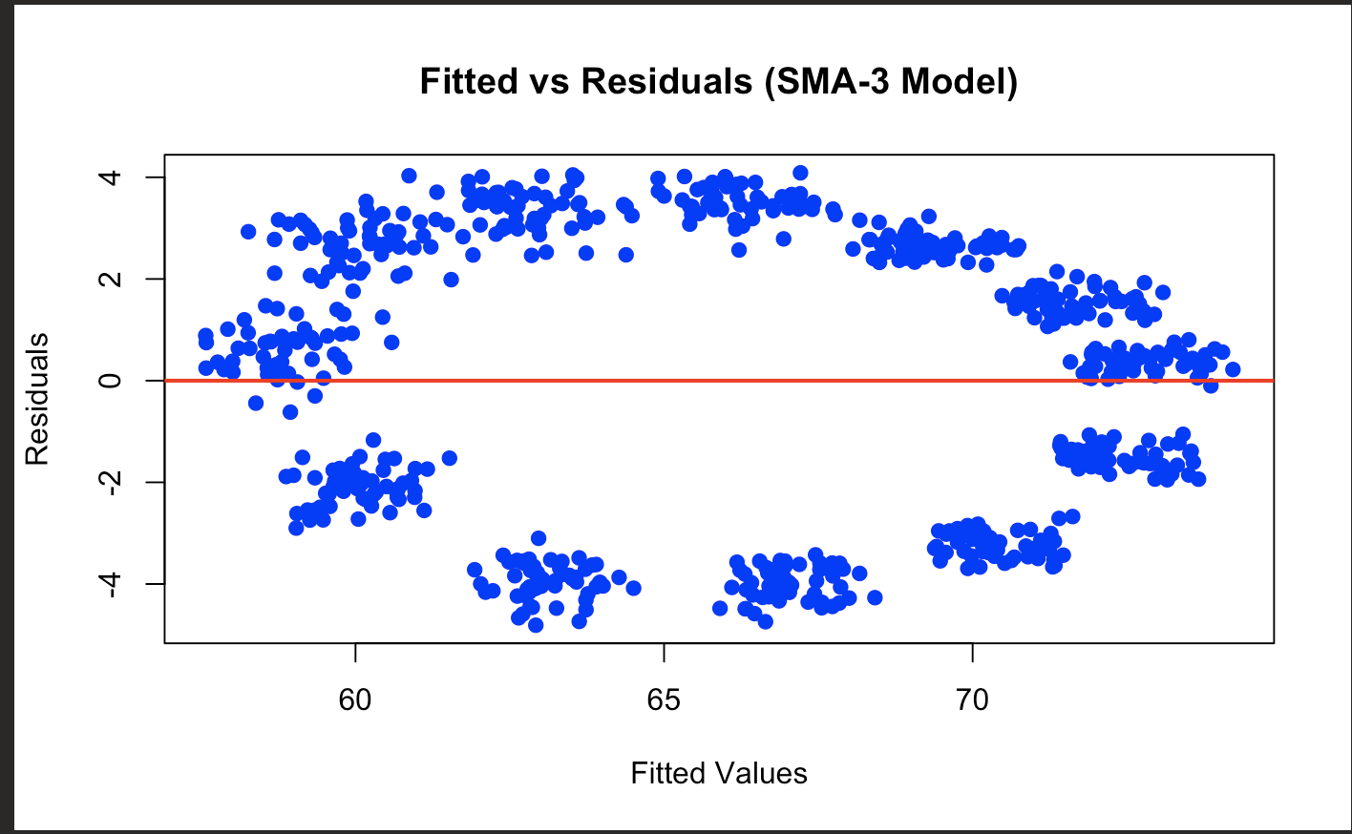
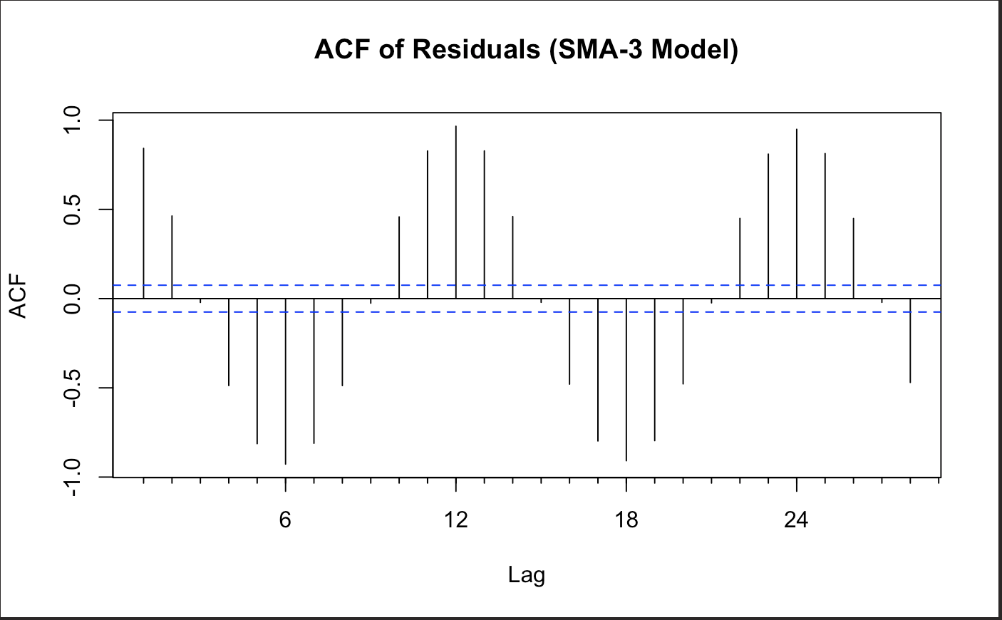
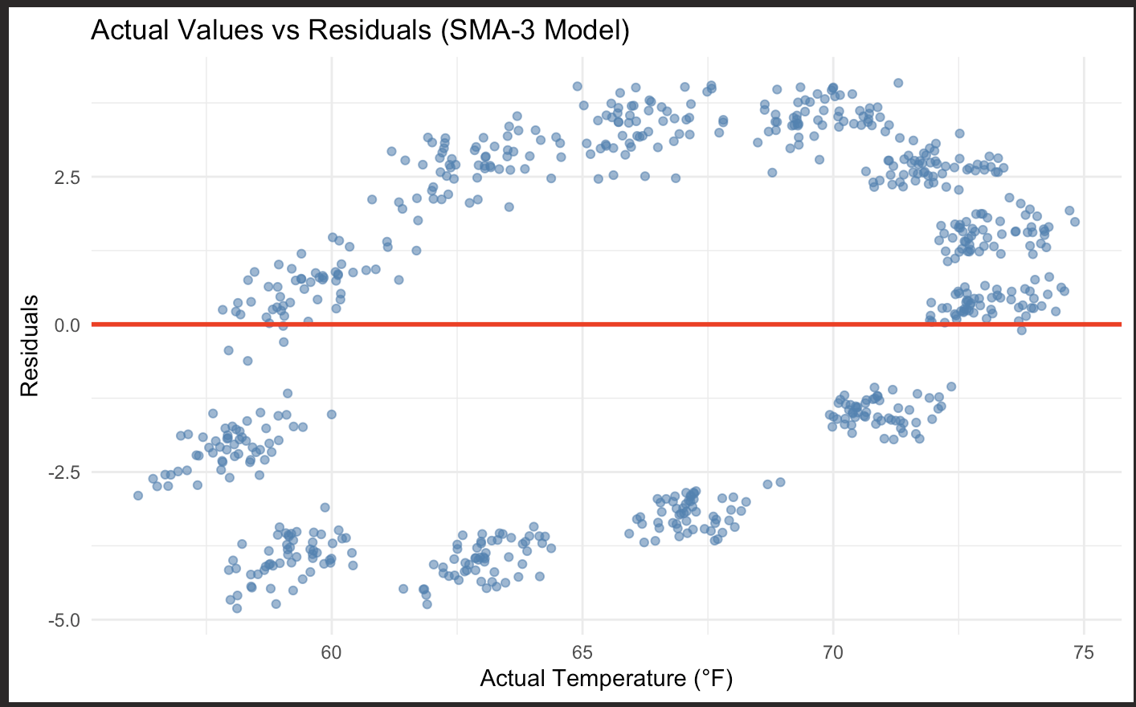
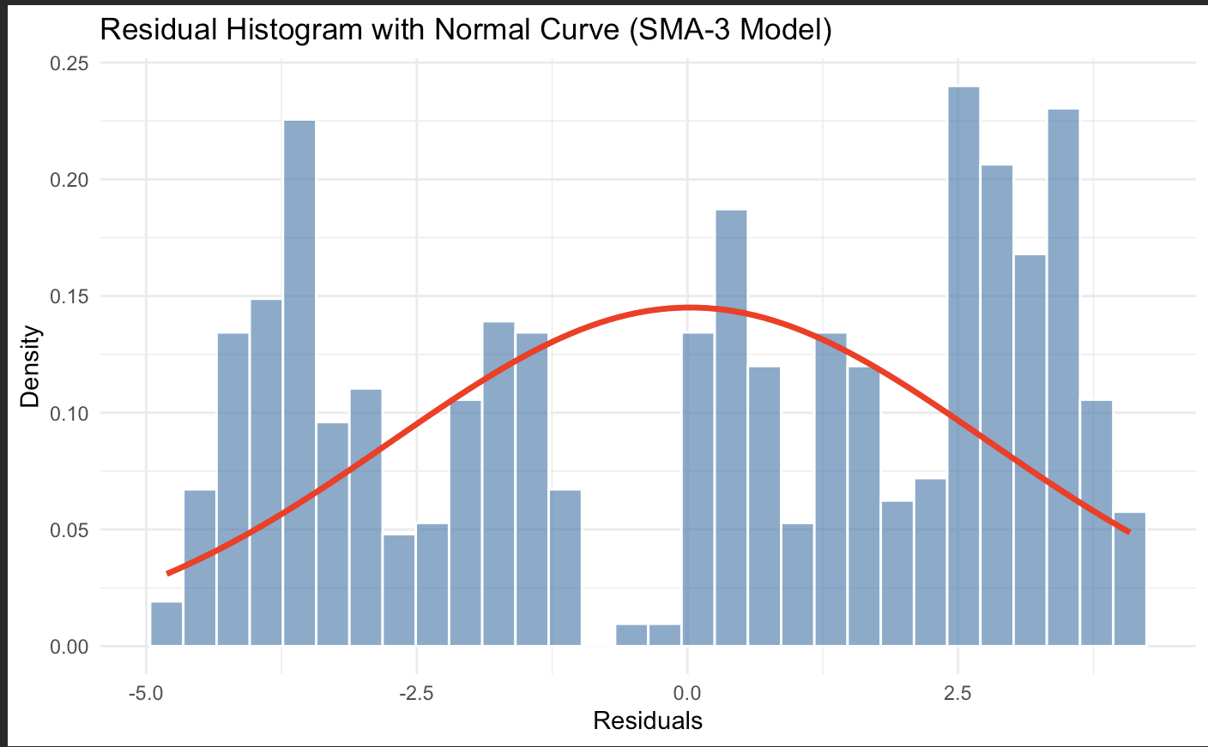
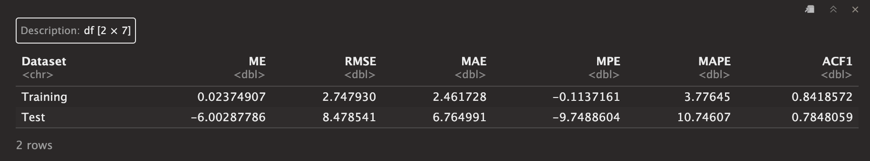
Simple Moving Average (3)

Slide 13
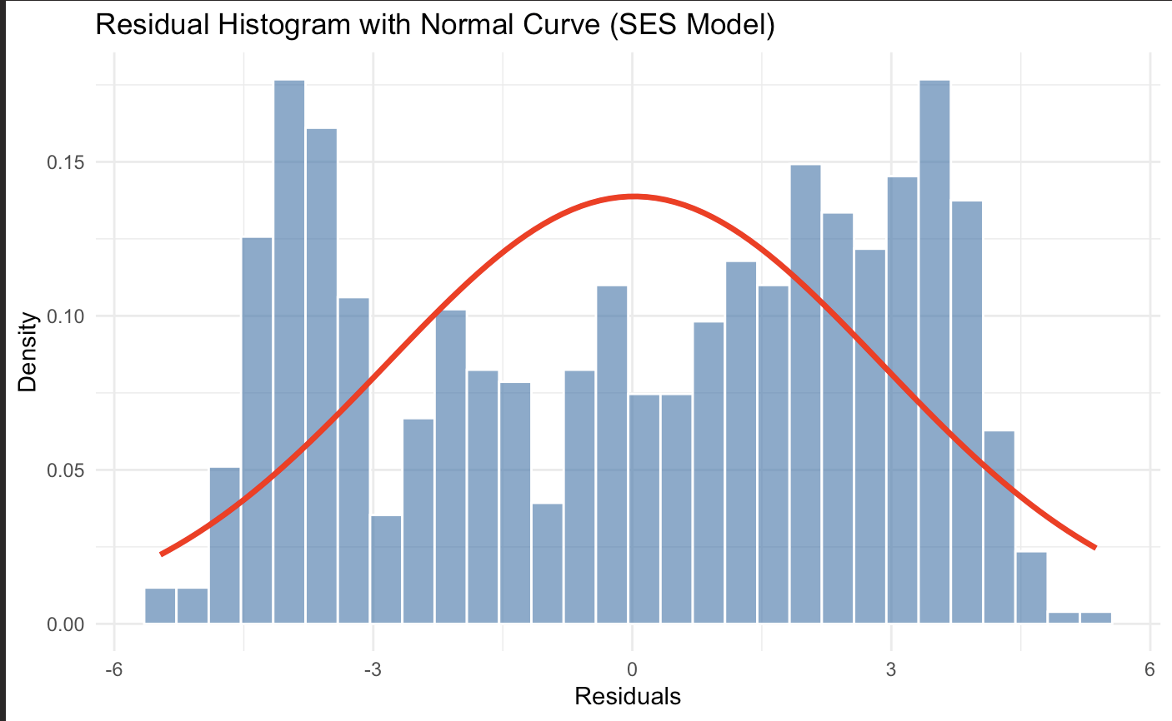
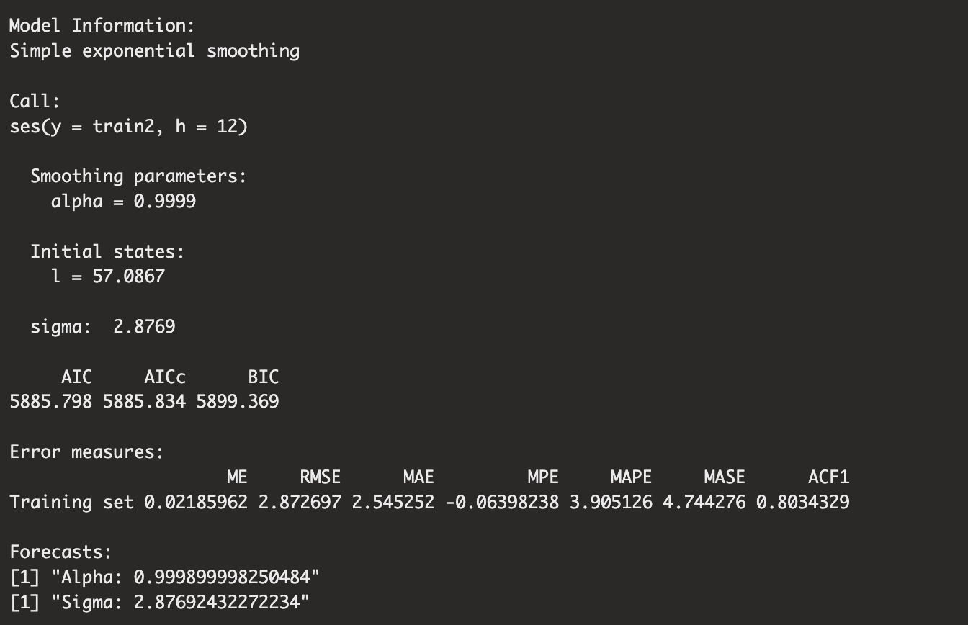
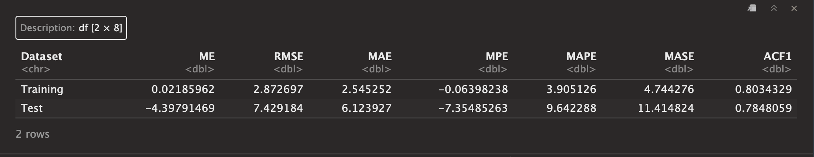
Simple Exponential Smoothing pt 1
Notes:
Alpha is high so the more recent values are more important .
Interpretation: If your Sigma is roughly 2.5, it means that on any given month, the actual temperature typically deviates from your forecast by about 2.5 degrees Fahrenheit. A lower Sigma means a more precise model.

Slide 14
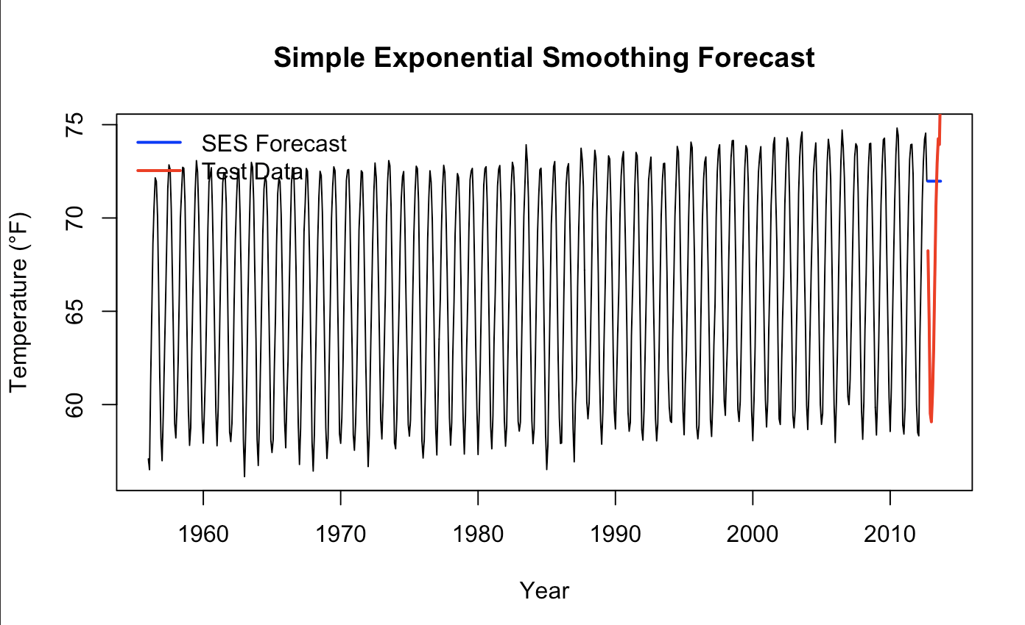
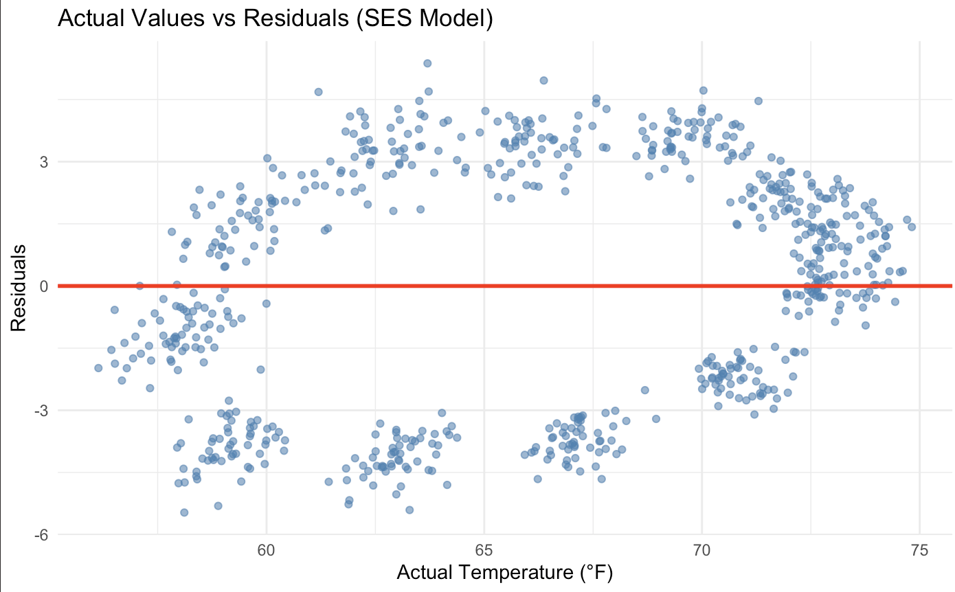
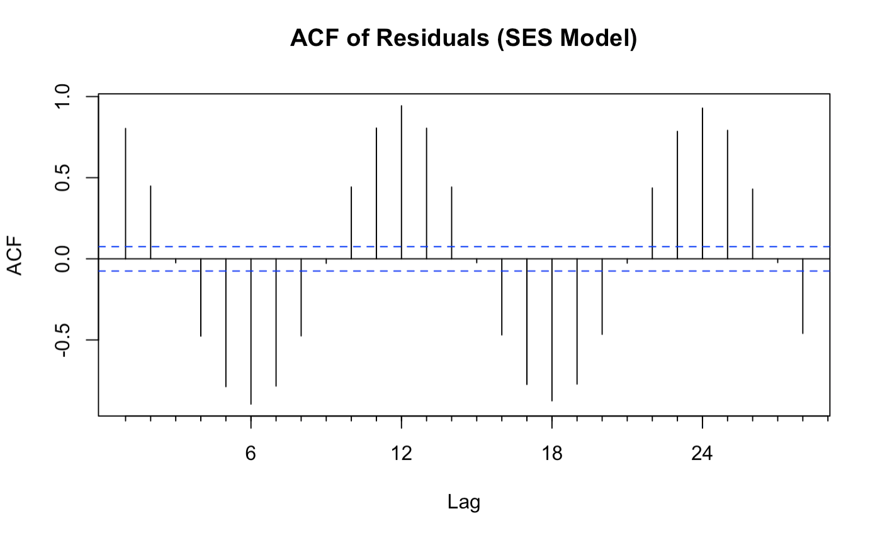
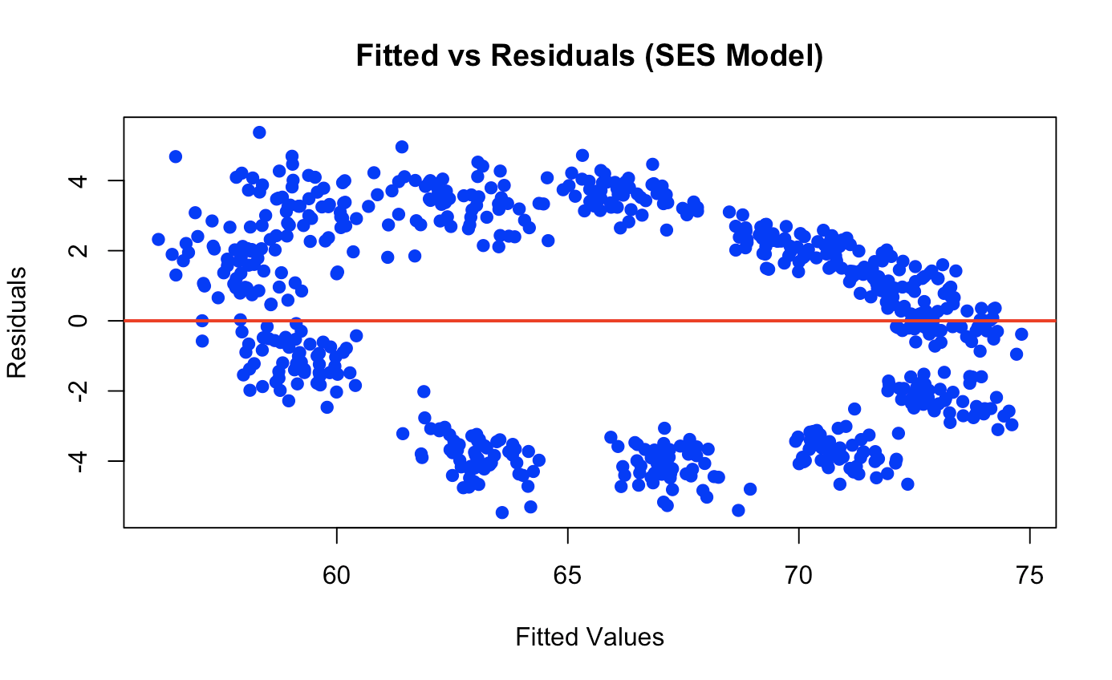
Simple Exponential Smoothing pt2
Notes:
Alpha is high so the more recent values are more important .
Interpretation: If your Sigma is roughly 2.5, it means that on any given month, the actual temperature typically deviates from your forecast by about 2.5 degrees Fahrenheit. A lower Sigma means a more precise model.

Slide 15
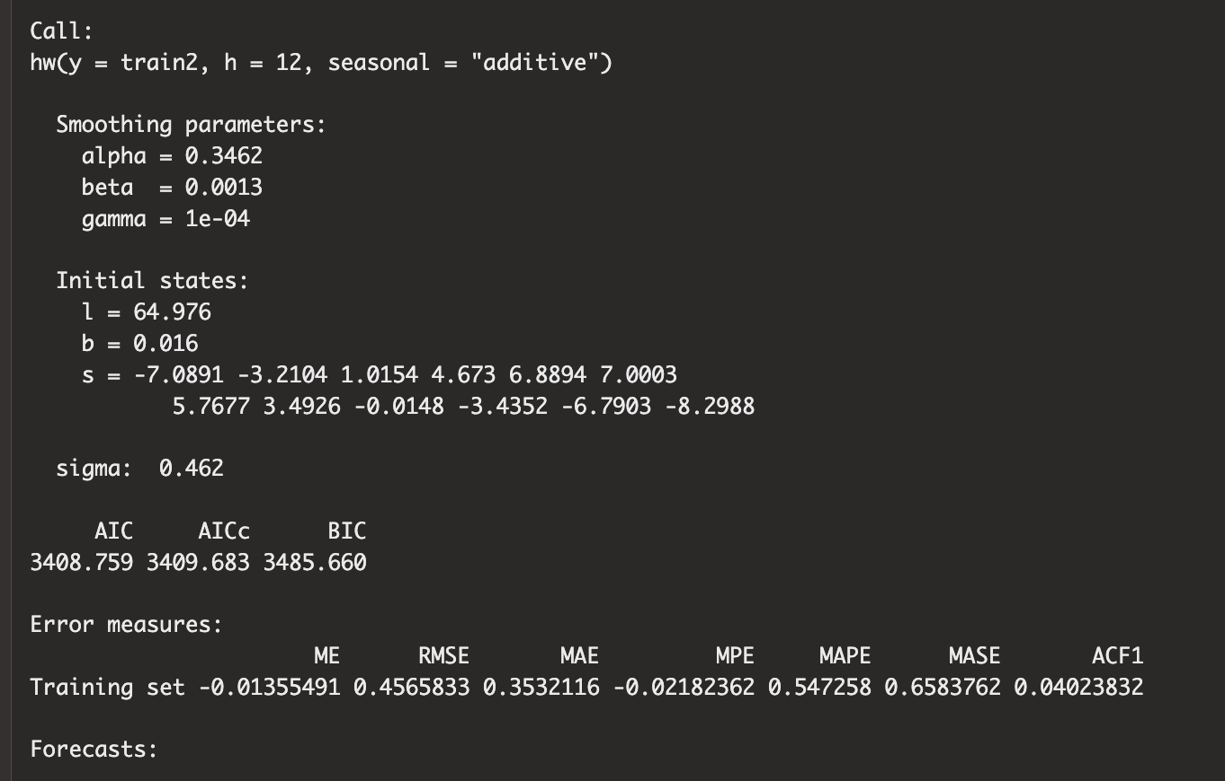
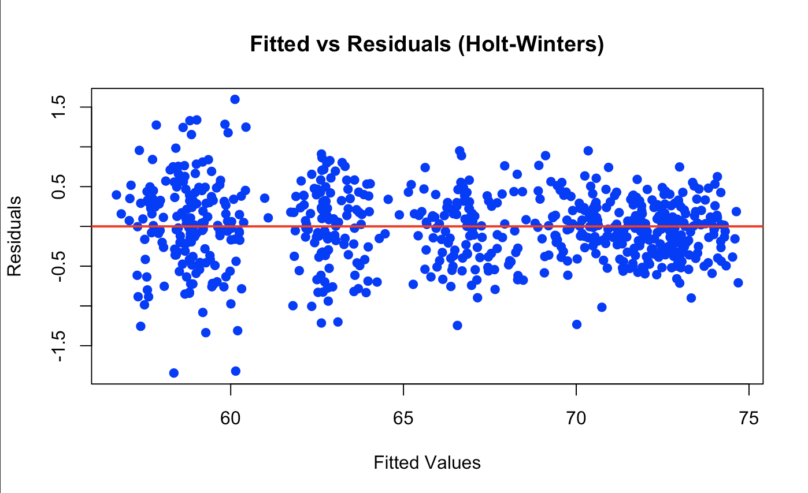
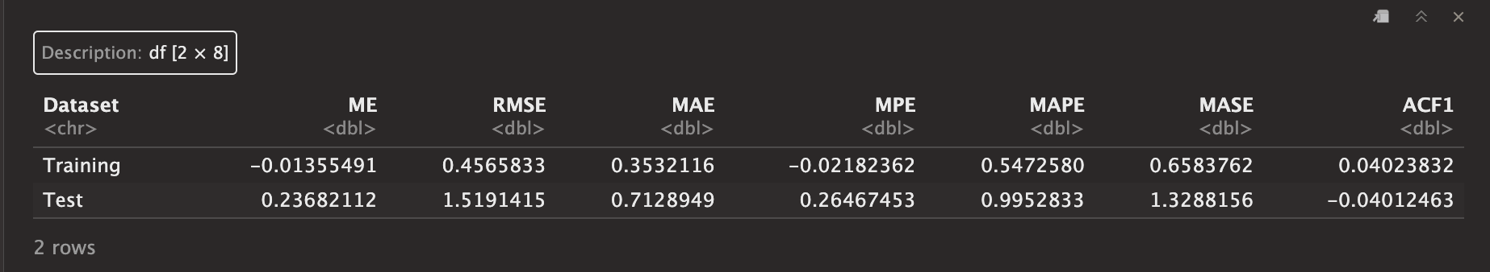
Holt Winters - Seasonal = Additive pt 1
Notes:
We used additive as in our data the seasonal variations in the time series are roughly constant and do not increase or decrease proportionally with the overall trend
Alpha (α) = 0.3462 (The Level)
Meaning: Moderate adaptation.
Analysis: The model gives about 35% weight to the most recent observation when updating the "baseline" temperature. It allows the baseline to shift over time (e.g., if a decade is warmer), but it doesn't react violently to a single hot month.
Beta (β) = 0.0013 (The Trend)
Meaning: Almost zero (Deterministic Trend).
Analysis: The model estimates that the slope of the warming trend changes very, very slowly. It isn't assuming the warming accelerates or decelerates rapidly month-to-month. It sees a steady, consistent upward drift.
Gamma (γ) = 0.0001 (The Seasonality)
Meaning: Effectively zero (Fixed Seasonality).
Analysis: This is perfect for weather data. A gamma near zero means the seasonal shape (the difference between January and July) stays constant over time.
The values under s (seasonality) show the additive adjustment for each month relative to the average level.
High: 7.0003 (The peak summer month adds ~7°F to the baseline).
Low: -8.2988 (The deep winter month subtracts ~8.3°F from the baseline).
Range: The swing from winter to summer is roughly 15.3°F.
4. Error Measures (Accuracy)
These numbers indicate the model is performing exceptionally well on the training data.
Sigma (σ) = 0.462:
The standard deviation of the errors is roughly 0.46°F. This means that in any given month, the model is usually within half a degree of the actual temperature.
MAPE = 0.547%:
The Mean Absolute Percentage Error is roughly 0.5%. This is extremely low. A MAPE under 5-10% is usually considered "good"; under 1% is rare and indicates a very strong signal.
ACF1 = 0.040:
The autocorrelation of residuals at lag 1 is 0.04 (very close to zero).
What this means: There is almost no information left in the errors. The model has successfully extracted the Trend and the Seasonality, leaving behind only random noise.

Slide 16
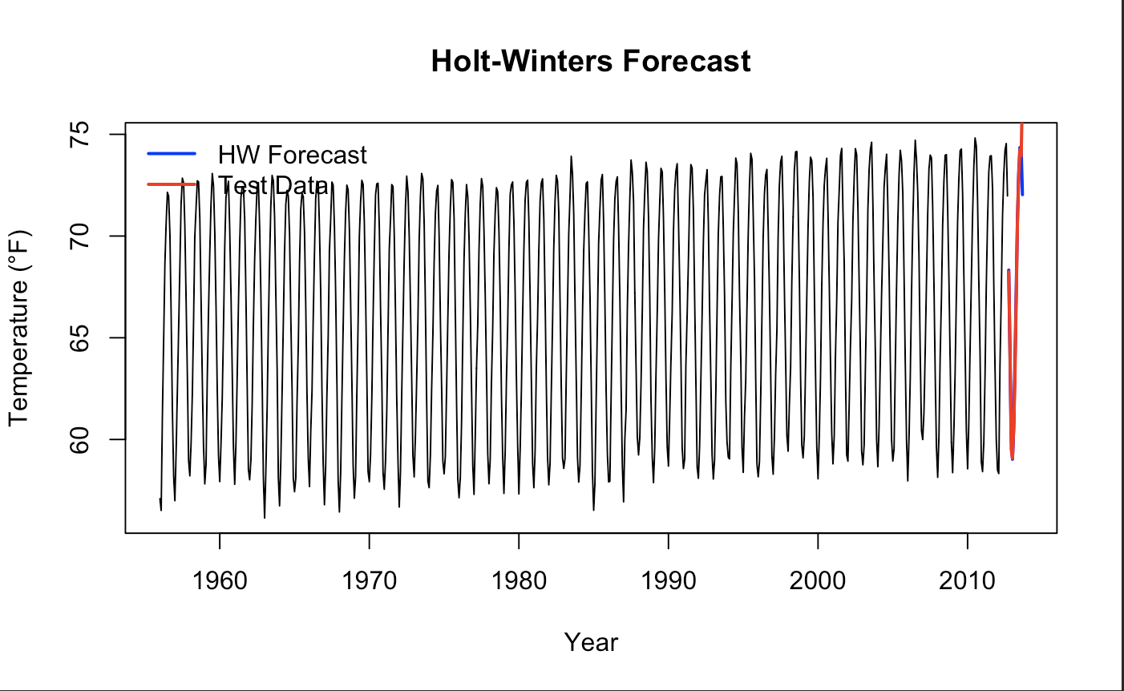
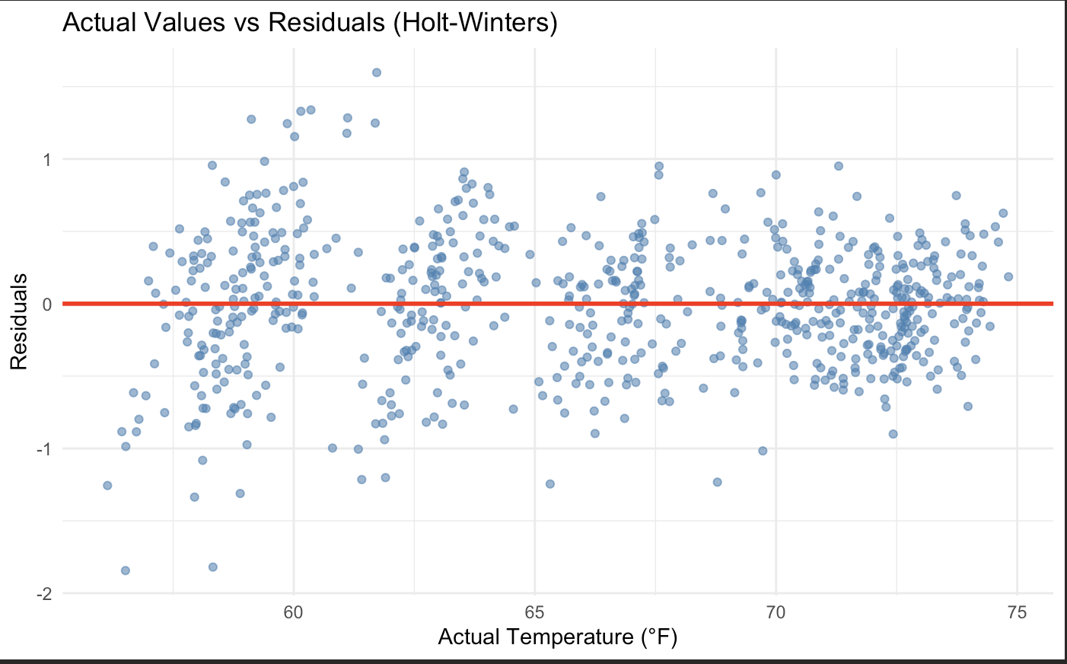
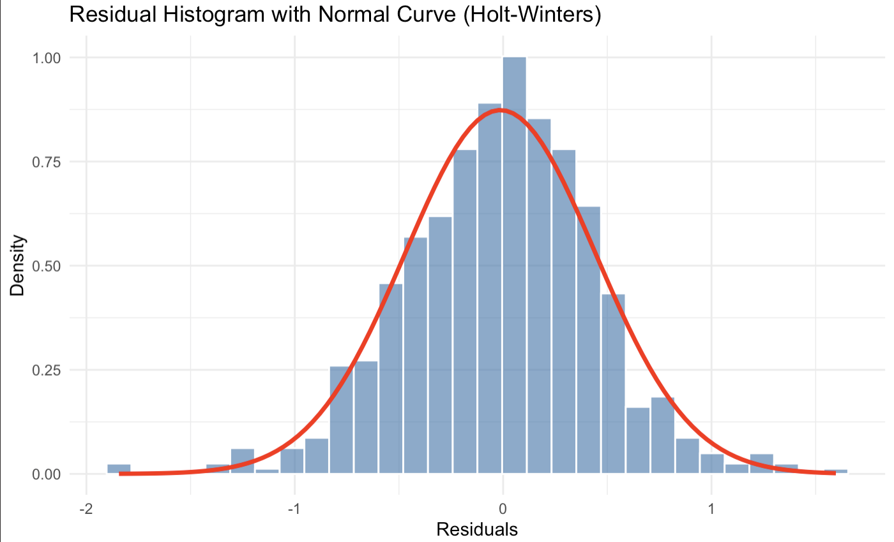
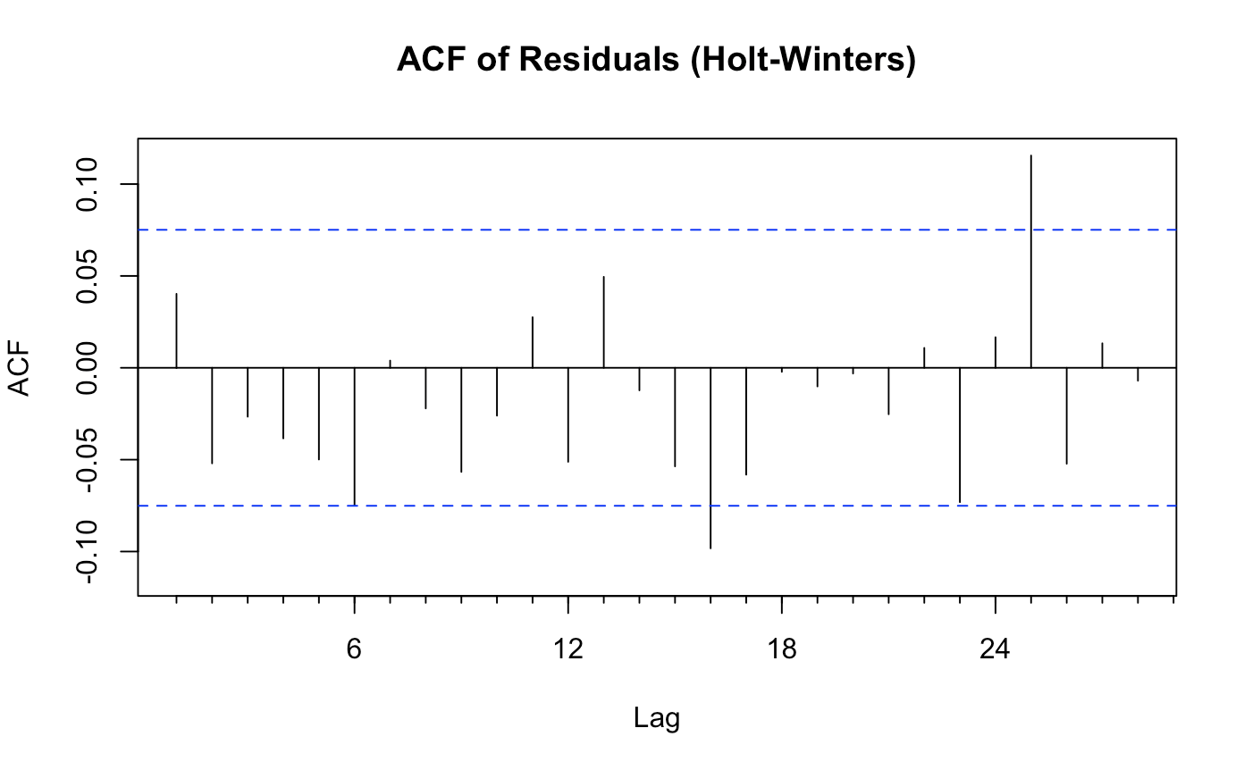
Holt Winters - Seasonal = Additive pt 2
Notes:
We used additive as in our data the seasonal variations in the time series are roughly constant and do not increase or decrease proportionally with the overall trend
Alpha (α) = 0.3462 (The Level)
Meaning: Moderate adaptation.
Analysis: The model gives about 35% weight to the most recent observation when updating the "baseline" temperature. It allows the baseline to shift over time (e.g., if a decade is warmer), but it doesn't react violently to a single hot month.
Beta (β) = 0.0013 (The Trend)
Meaning: Almost zero (Deterministic Trend).
Analysis: The model estimates that the slope of the warming trend changes very, very slowly. It isn't assuming the warming accelerates or decelerates rapidly month-to-month. It sees a steady, consistent upward drift.
Gamma (γ) = 0.0001 (The Seasonality)
Meaning: Effectively zero (Fixed Seasonality).
Analysis: This is perfect for weather data. A gamma near zero means the seasonal shape (the difference between January and July) stays constant over time.
The values under s (seasonality) show the additive adjustment for each month relative to the average level.
High: 7.0003 (The peak summer month adds ~7°F to the baseline).
Low: -8.2988 (The deep winter month subtracts ~8.3°F from the baseline).
Range: The swing from winter to summer is roughly 15.3°F.
4. Error Measures (Accuracy)
These numbers indicate the model is performing exceptionally well on the training data.
Sigma (σ) = 0.462:
The standard deviation of the errors is roughly 0.46°F. This means that in any given month, the model is usually within half a degree of the actual temperature.
MAPE = 0.547%:
The Mean Absolute Percentage Error is roughly 0.5%. This is extremely low. A MAPE under 5-10% is usually considered "good"; under 1% is rare and indicates a very strong signal.
ACF1 = 0.040:
The autocorrelation of residuals at lag 1 is 0.04 (very close to zero).
What this means: There is almost no information left in the errors. The model has successfully extracted the Trend and the Seasonality, leaving behind only random noise.

Slide 17
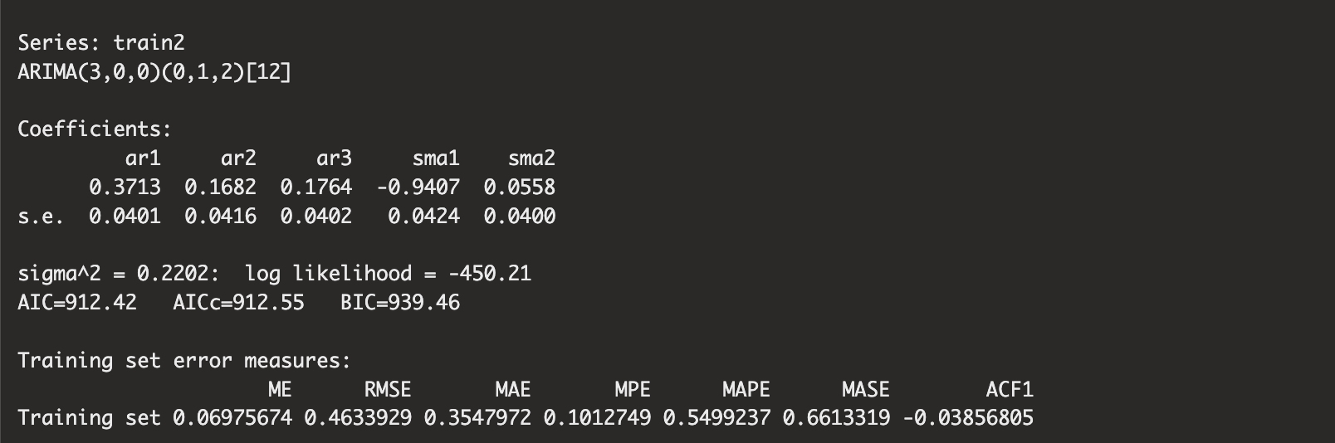
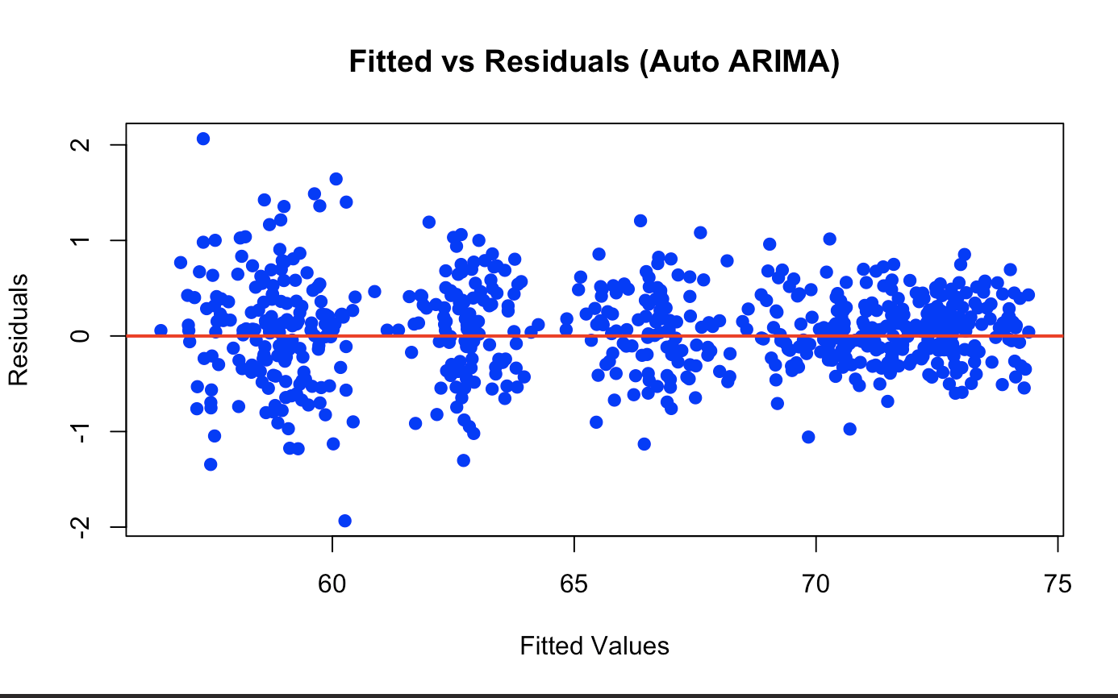
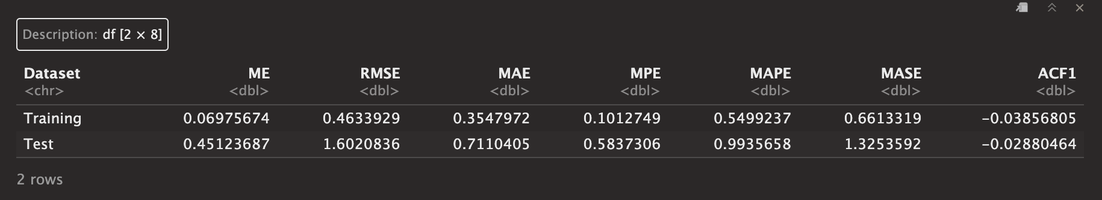
ARIMA / SARIMA pt 1
Notes:
1. The Model: ARIMA(3,0,0)(0,1,2)[12]
This notation tells us exactly how the model constructs its prediction. It has two parts:
A. Non-Seasonal Part: (3,0,0)
p = 3 (AR - AutoRegressive): The model looks at the last 3 months of temperatures to predict the current one. It assumes that if it was hot in March, April, and May, that momentum affects June.
d = 0 (I - Integrated): No "regular" differencing was needed. The model didn't need to subtract today from yesterday to make the data stationary, likely because the seasonal differencing handled the main trends.
q = 0 (MA - Moving Average): It does not use non-seasonal moving averages (errors from recent months) to correct the forecast.
B. Seasonal Part: (0,1,2)[12]
P = 0 (Seasonal AR): It doesn't strictly look at the temperature value from 12 months ago as a direct predictor.
D = 1 (Seasonal Differencing): Crucial. The model subtracts this year's January from last year's January (and so on). This removes the seasonal "wave" and allows the model to focus on the anomalies.
Q = 2 (Seasonal MA): It looks at the errors from 12 months ago and 24 months ago to correct itself. If the model over-predicted last July, it uses that mistake to adjust the forecast for this July.
[12]: The season repeats every 12 periods (monthly).
2. Coefficients (The "Weights")
ar1 (0.37), ar2 (0.17), ar3 (0.18): These are positive, meaning recent months have a positive correlation with the next month (a warm month tends to follow warm months).
sma1 (-0.94): This is a very strong negative weight on the seasonal error. It effectively says, "If I made a mistake forecasting last year's season, correct it aggressively in the opposite direction."

Slide 18
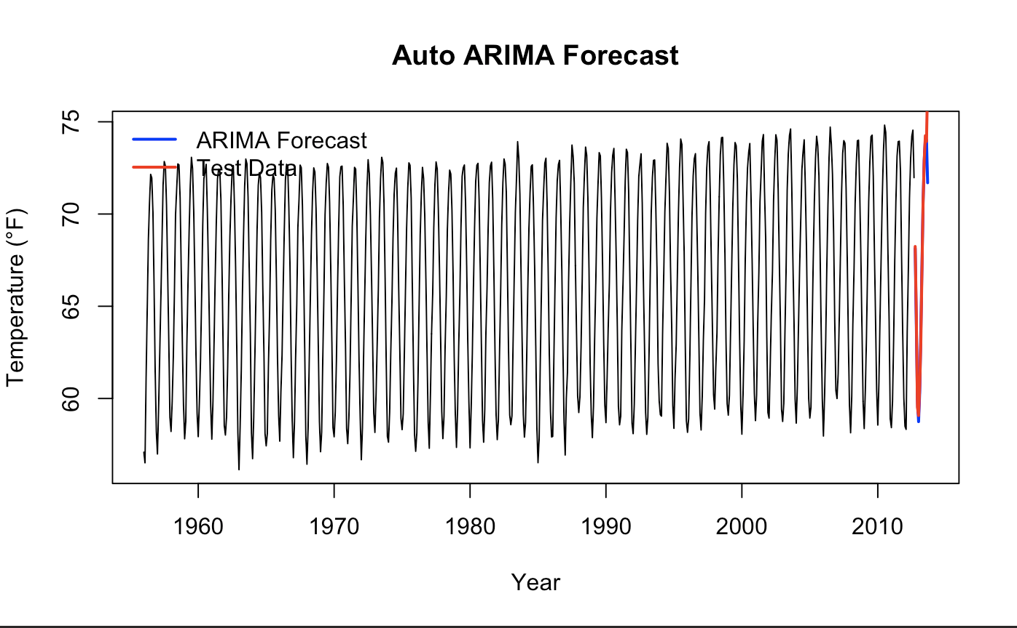
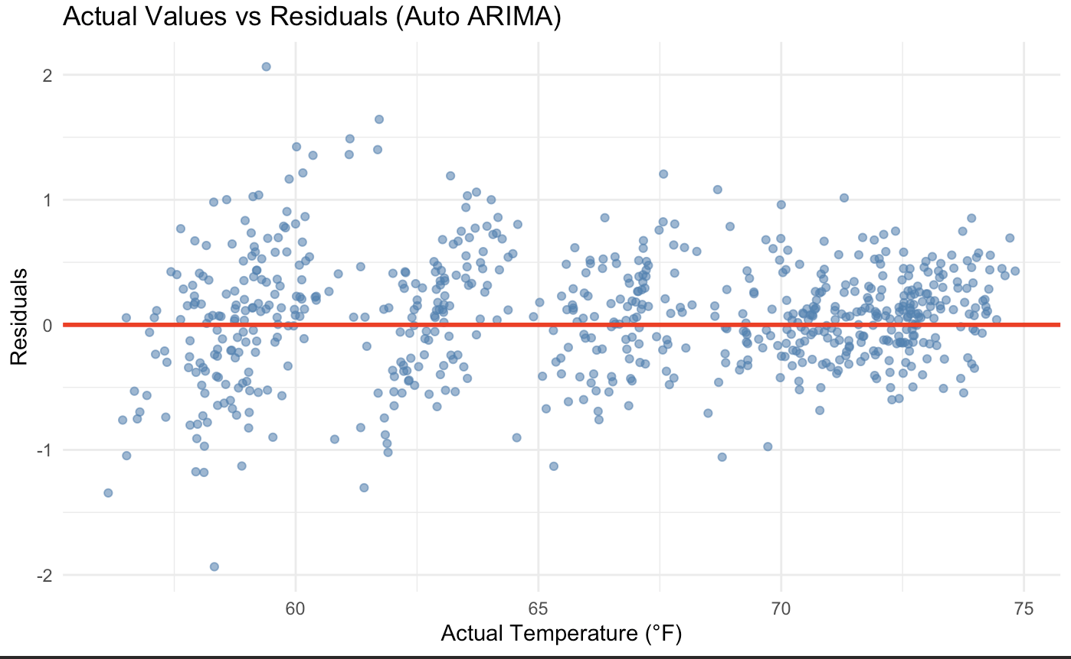
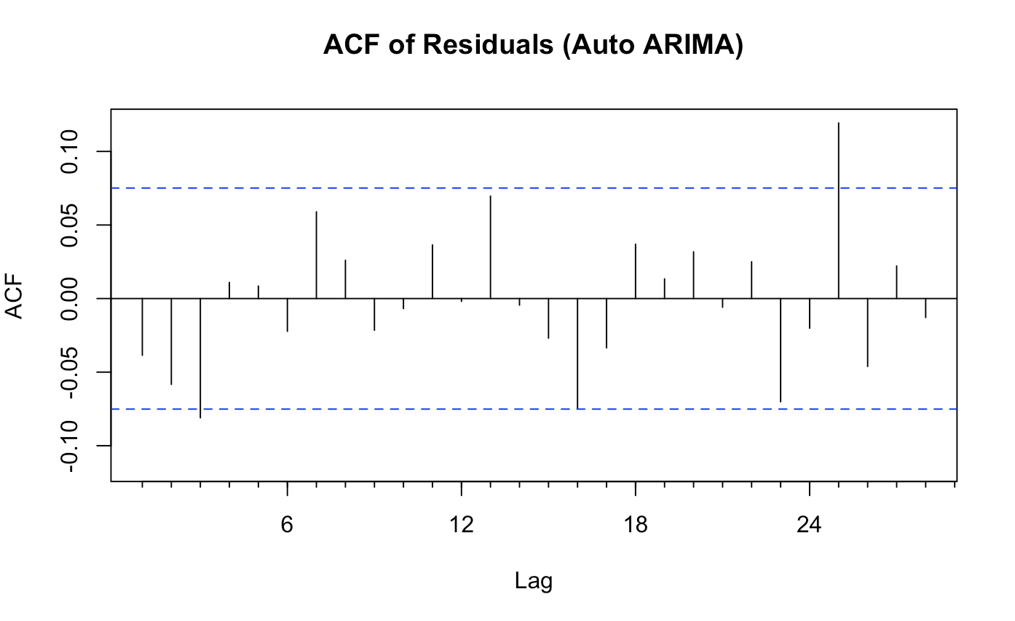
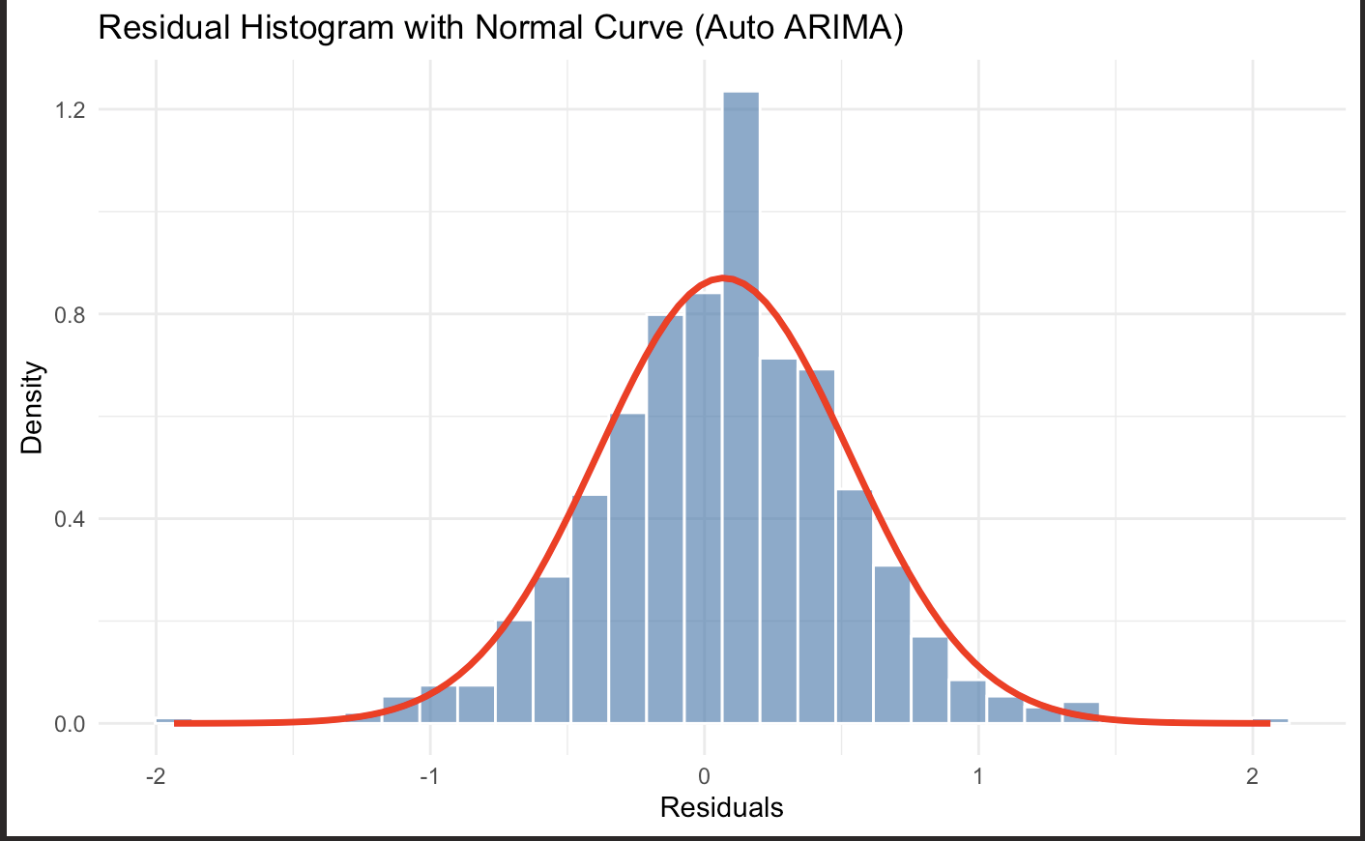
ARIMA / SARIMA pt 2
Notes:
1. The Model: ARIMA(3,0,0)(0,1,2)[12]
This notation tells us exactly how the model constructs its prediction. It has two parts:
A. Non-Seasonal Part: (3,0,0)
p = 3 (AR - AutoRegressive): The model looks at the last 3 months of temperatures to predict the current one. It assumes that if it was hot in March, April, and May, that momentum affects June.
d = 0 (I - Integrated): No "regular" differencing was needed. The model didn't need to subtract today from yesterday to make the data stationary, likely because the seasonal differencing handled the main trends.
q = 0 (MA - Moving Average): It does not use non-seasonal moving averages (errors from recent months) to correct the forecast.
B. Seasonal Part: (0,1,2)[12]
P = 0 (Seasonal AR): It doesn't strictly look at the temperature value from 12 months ago as a direct predictor.
D = 1 (Seasonal Differencing): Crucial. The model subtracts this year's January from last year's January (and so on). This removes the seasonal "wave" and allows the model to focus on the anomalies.
Q = 2 (Seasonal MA): It looks at the errors from 12 months ago and 24 months ago to correct itself. If the model over-predicted last July, it uses that mistake to adjust the forecast for this July.
[12]: The season repeats every 12 periods (monthly).
2. Coefficients (The "Weights")
ar1 (0.37), ar2 (0.17), ar3 (0.18): These are positive, meaning recent months have a positive correlation with the next month (a warm month tends to follow warm months).
sma1 (-0.94): This is a very strong negative weight on the seasonal error. It effectively says, "If I made a mistake forecasting last year's season, correct it aggressively in the opposite direction."

Slide 19
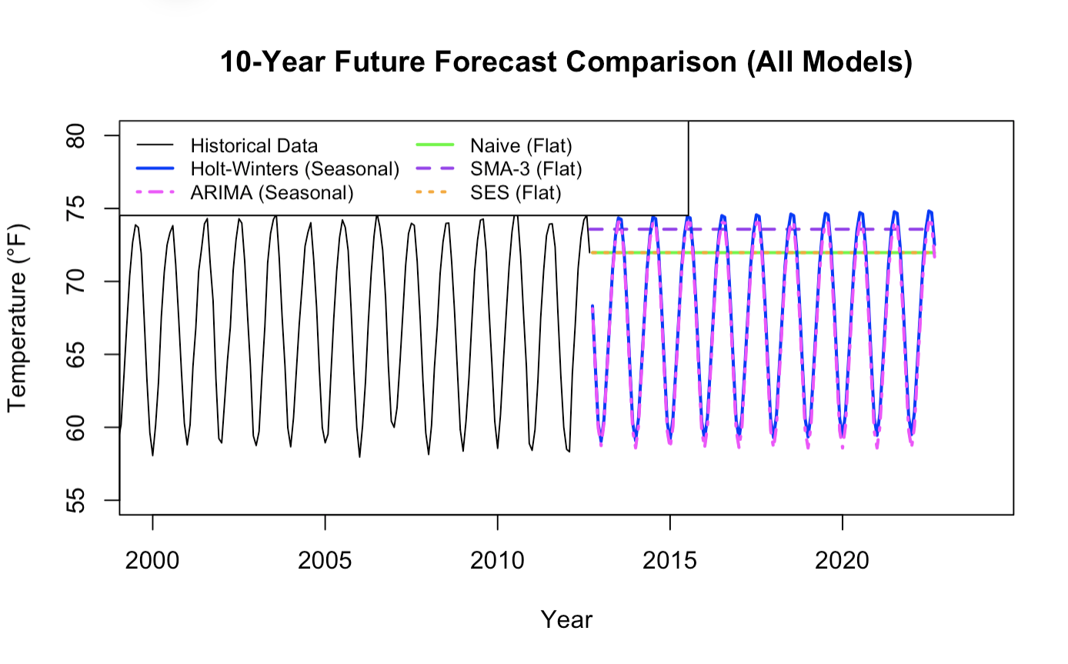
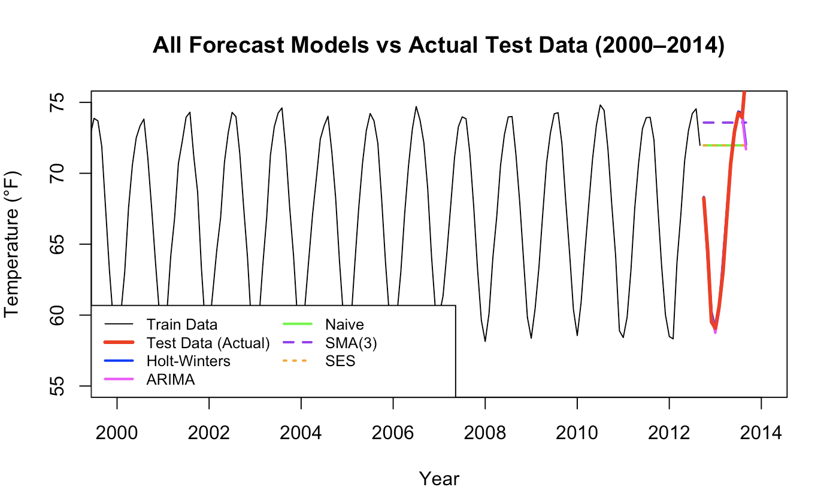
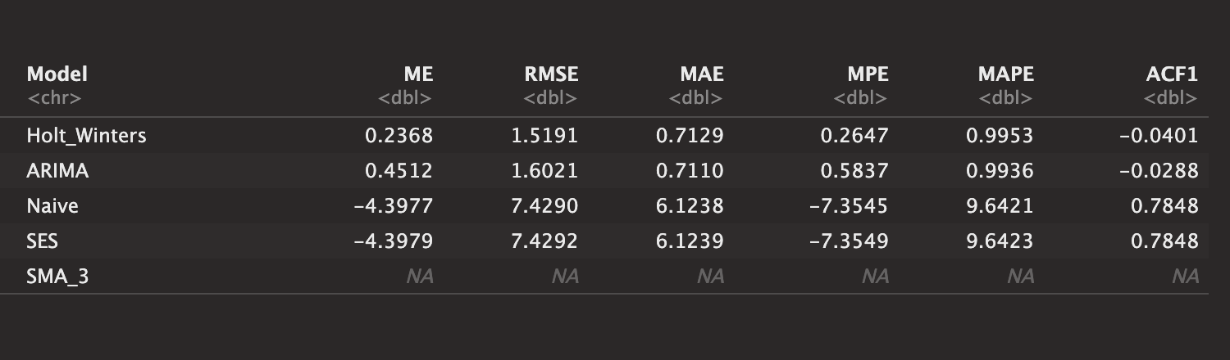
Comparing Results - Performance On Test

Slide 20
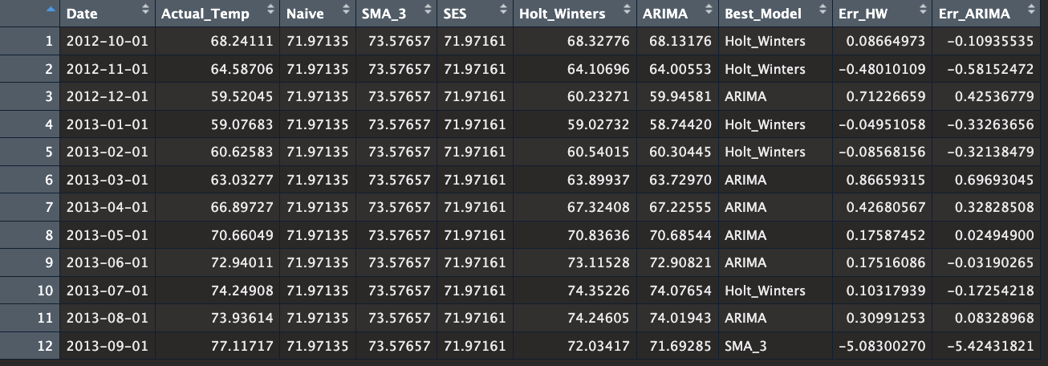
Comparing Results - Performance On Test
Time Complexity in terms of N = where n is size of dataset
Naive | SMA | SES | Holt Winters | ARIMA (AUTO)`
O(1) | O(N) | O(N) | O(N) | O(NXG)

Slide 21
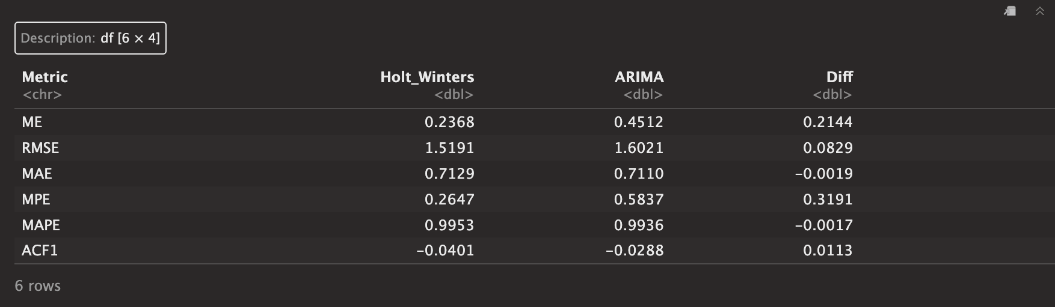
Recommendation - Final Model Selection
From the comparison view of performance on the test set between all models it is clear that Holt Winters and ARIMA models are performing best
Only the Holt Winters and ARIMA models show from their residual analysis that they are properly capturing the structure in the data and meeting our assumptions
Our Chosen metrics were MAE and RMSE . HW has higher MAE then ARIMA by 0.0019 but HW has lower RMSE then ARIMA by 0.0829, on the test set.
Given HW only is slightly worse in MAE but ARIMA has a noticeable drop in RMSE , I will choose Holt Winters as my final model

Slide 22
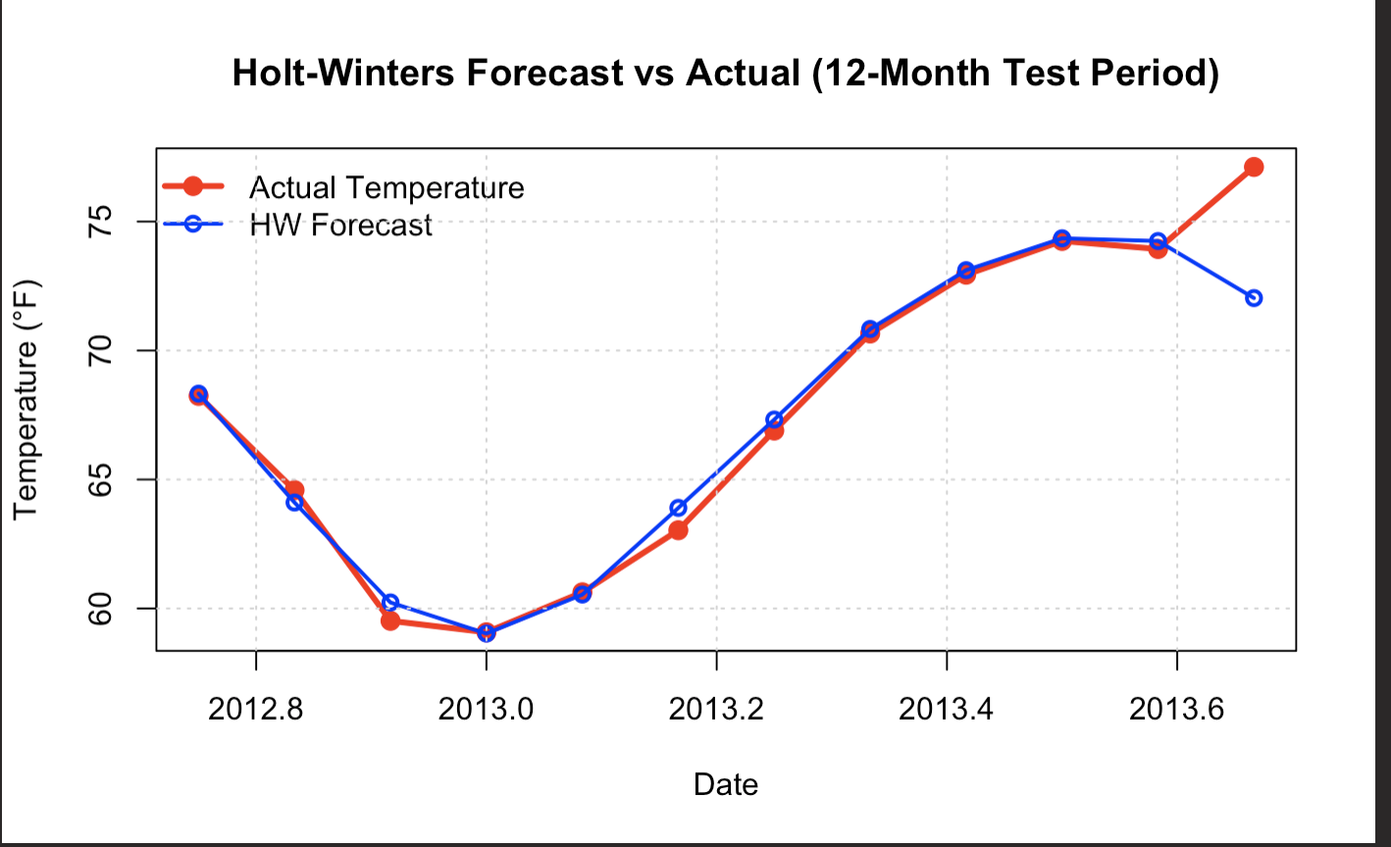
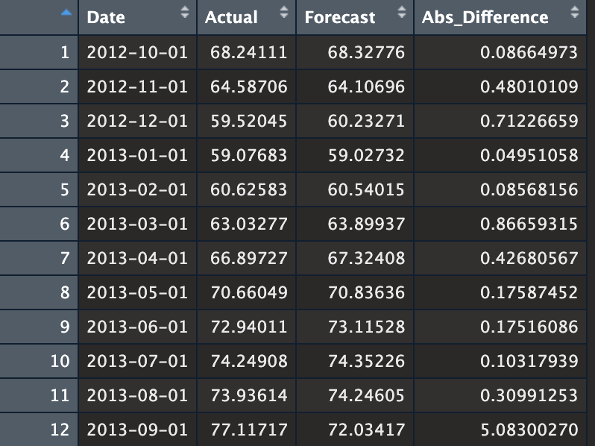
Forecast and Conclusion
Implication : We are now able to predict global monthly temperatures with rmse of 1.5 and mae of 0.71 fahrenheit . We can now forecast into the future knowing our forecasts will be accurate and we can use the trained Holt Winter Model to prepare for rising global temperatures

Slide 23
Future Steps
Create ensemble model between Holt Winters and ARIMA . Where each models prediction is multiplied by a weight , this weight between Holt Winters and ARIMA should add to one . We can use grid search or random search with k fold cross validation on our training set to find the optimal weight values for the Holt Winter and ARIMA model .
Try more complex and recent time series models (Prophet by META , Neural Network Autogression to allow for non linear relationships , LSTM )

